Slide 1

Sardar Patel College of Engineering, Bakrol
Mr.Bharat Vadhiya
Assistant Professor
Department of H & AS
Subject : CPDP (3150004)
Semester : I

Slide 2

The Contributor Work Ideal

Slide 3
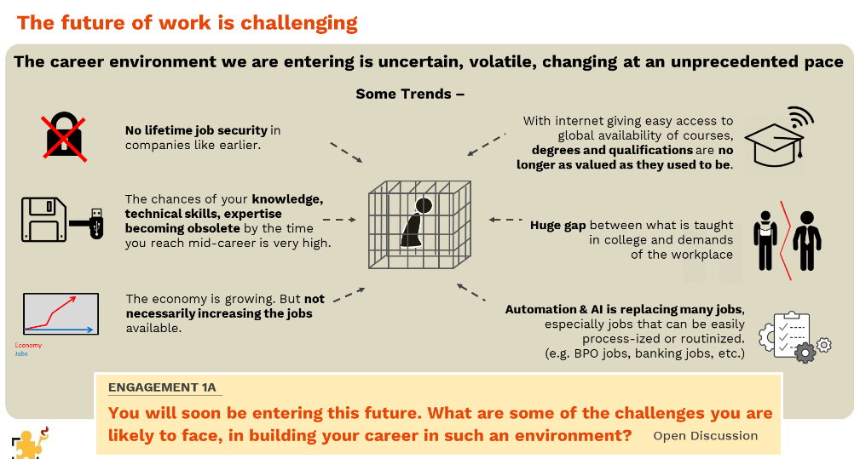

Slide 4


Slide 5


Slide 6

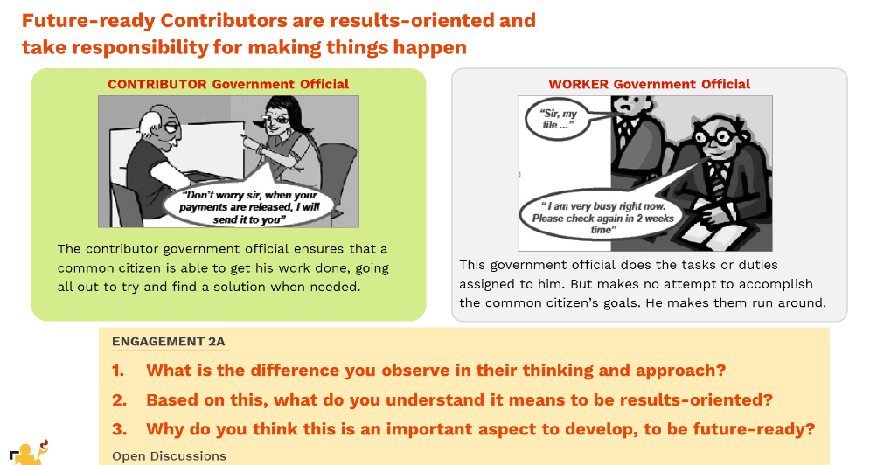

Slide 7
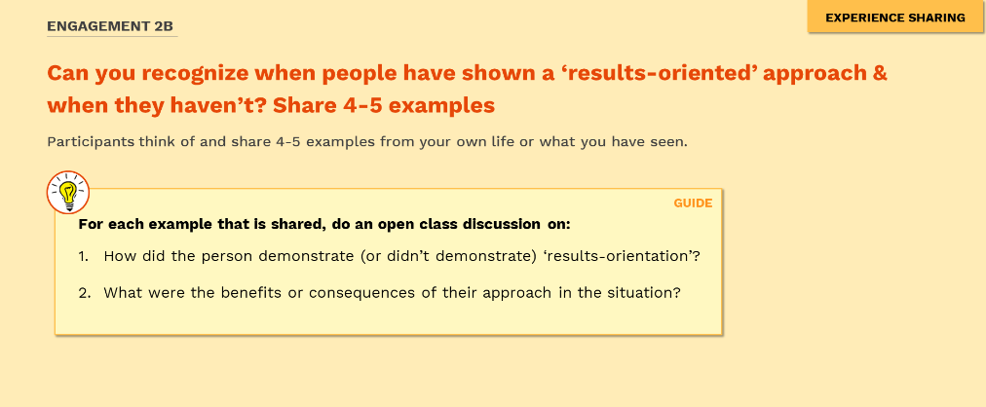


Slide 8
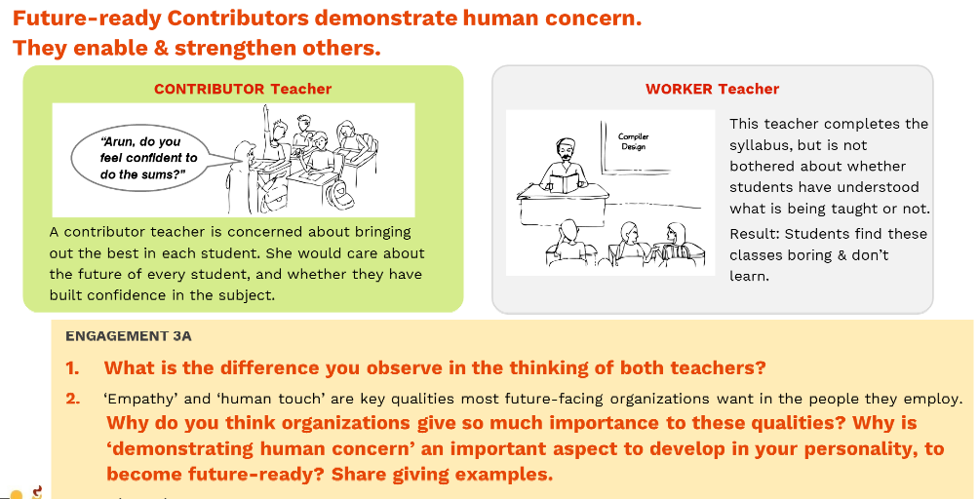

Slide 9
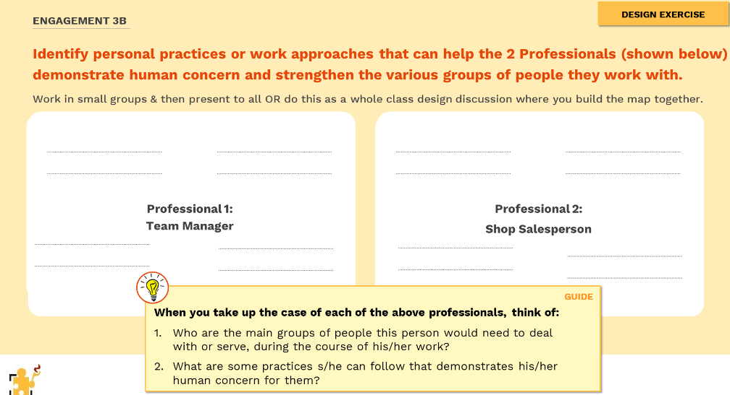

Slide 10



Slide 11
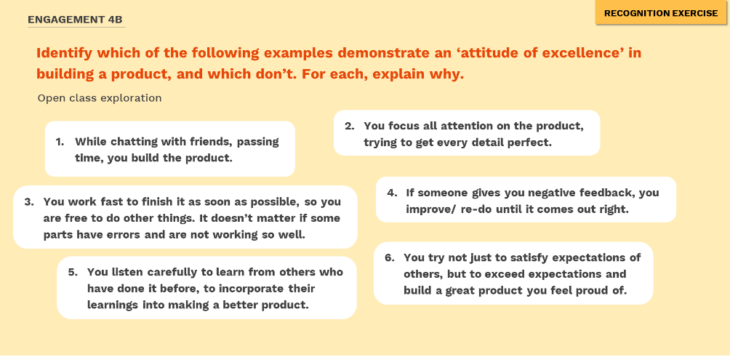

Slide 12


Slide 13


Slide 14


Slide 15
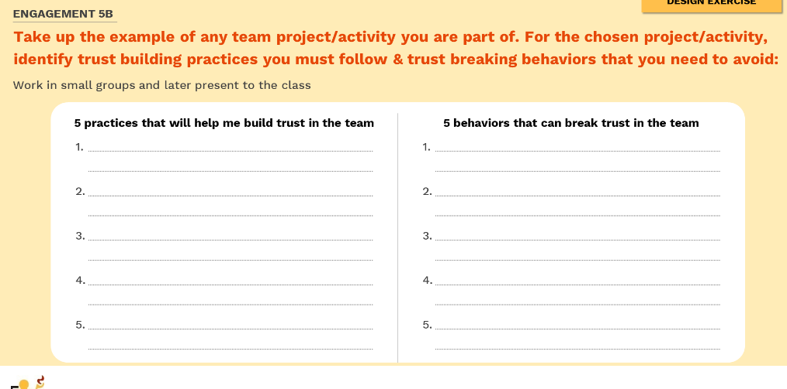

Slide 16
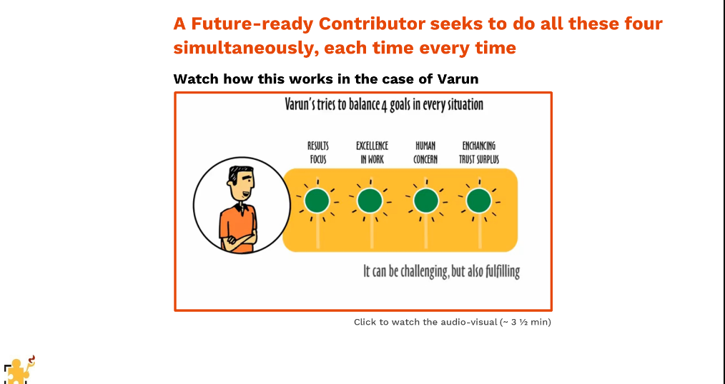
The Contributor’s Checklist

Slide 17
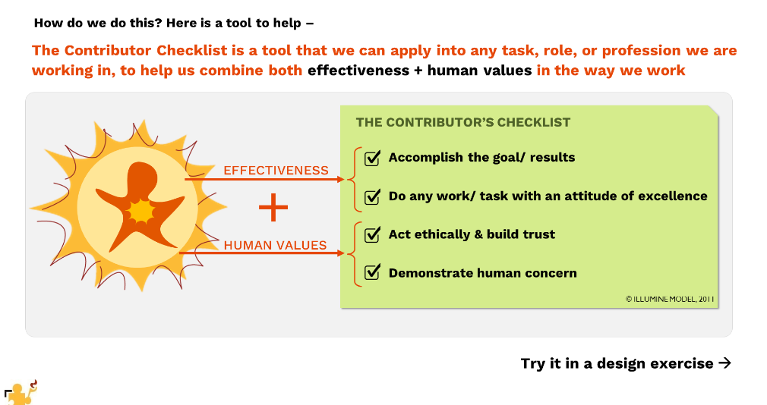

Slide 18
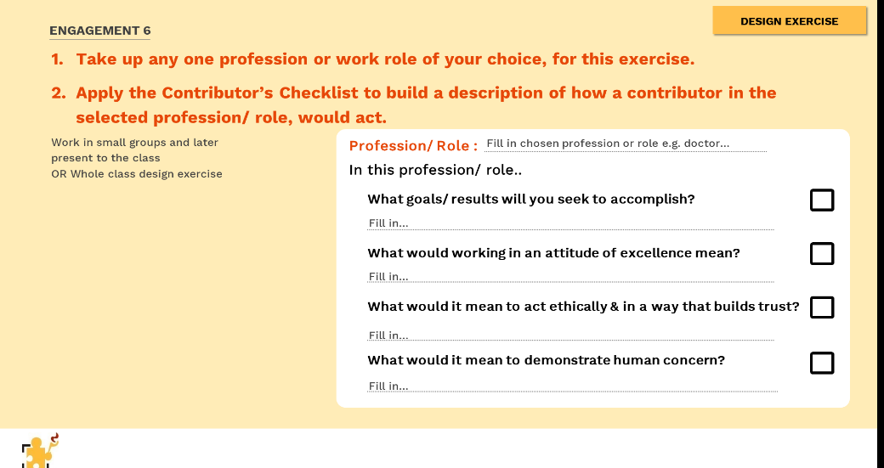

Slide 19


Slide 20


Slide 21
